Slide 1
Financial Analysis of Apple Inc. Presented by Group 2

Slide 2
Group Members
Pearlin Pereira
Jerusha Maben
Vinod Solomon
Roshan Khan
Vittlesh

Slide 3
Abstract
Purpose
Methods
Findings
Conclusion

Slide 4

Introduction
This project undertakes a comprehensive financial analysis of Apple Inc., a leader in the global technology market, renowned for its innovative products and robust financial performance. Through a combination of ratio analysis, Capital Asset Pricing Model (CAPM) calculations, Monte Carlo simulations, and Facebook Prophet forecasting, this study provides an integrated view of the company's financial health and market position.
Apple's journey from a garage startup to a global technology behemoth is a testament to its innovative drive. Today, Apple's product suite extends from iPhones to services like Apple Pay, supported by a macroeconomic strategy focused on sustained organic growth and strategic acquisitions.

Slide 5

FINANCIAL PERFORMANCE OVERVIEW
Financial ratios distill complex financial statements into understandable metrics. They provide essential insights into Apple's operational efficiency, liquidity management, and value proposition to investors.
Our ratio analysis reveals Apple's substantial profit margins and efficient use of equity, asserting its financial prowess. A considered review of liquidity measures suggests Apple is well-positioned to manage its short-term obligations while aggressively pursuing growth opportunities

Slide 6
Ratio and Valuation Analysis
1 | Profitability Ratios:
 | Net Profit Margin | (Net Income / Revenue) * 100 | 25.30%
 | Return on Assets (ROA) | (Net Income / Total Assets) * 100 | 27.50%
 | Return on Equity (ROE) | (Net Income / Shareholders' Equity) * 100 | 156.07%
2 | Liquidity Ratios:
 | Current Ratio | Current Assets / Current Liabilities | 0.98
 | Ǫuick Ratio | (Current Assets - Inventory) / Current Liabilities | 0.94
4 | Dividend Payout Ratio | (Dividends Paid / Net Income) * 100 | 15.46%
 | Sustainability Growth Rate | roe / 100 * (1 – dividend payout ratio) | 132 %
5 | Debt-to-Equity Ratio | Total Debt / Shareholders' Equity | 4.67

Slide 7

Overall Assessment
Apple demonstrates strong profitability, efficient asset utilization, and moderate financial leverage. While liquidity ratios suggest relatively tight liquidity positions, the company's robust cash reserves and stable cash flows mitigate liquidity risks. Additionally, the moderate dividend payout ratio and high sustainable growth rate underscore Apple's ability to balance shareholder returns with reinvestment for future growth.

Slide 8

SMA and EMA
SMAs (Simple Moving Average) are calculated by taking the average of the stock prices over the specified period (20 or 50 days). They provide a smoothed indication of the price trend.
EMAs (Exponential Moving Average) give more weight to recent prices, making them more responsive to new information. This can be particularly useful for traders following short-term trends.

Slide 9
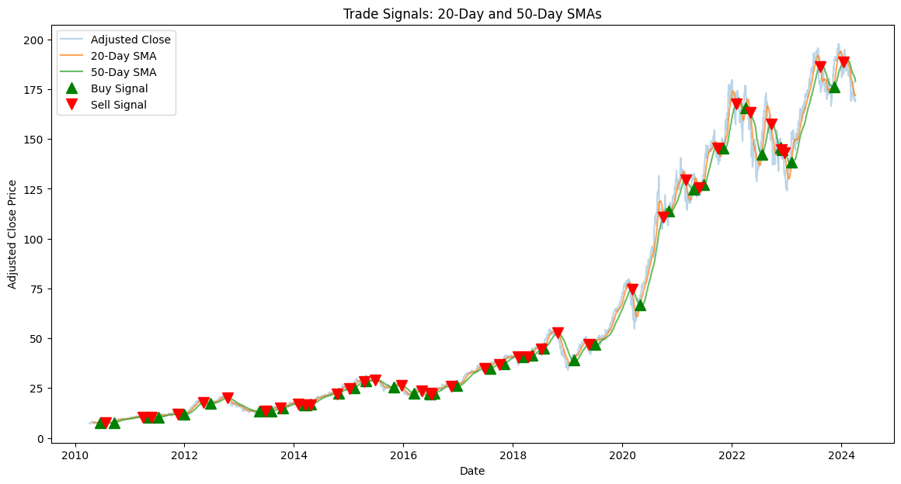
Simple Moving Average (SMA)

Slide 10
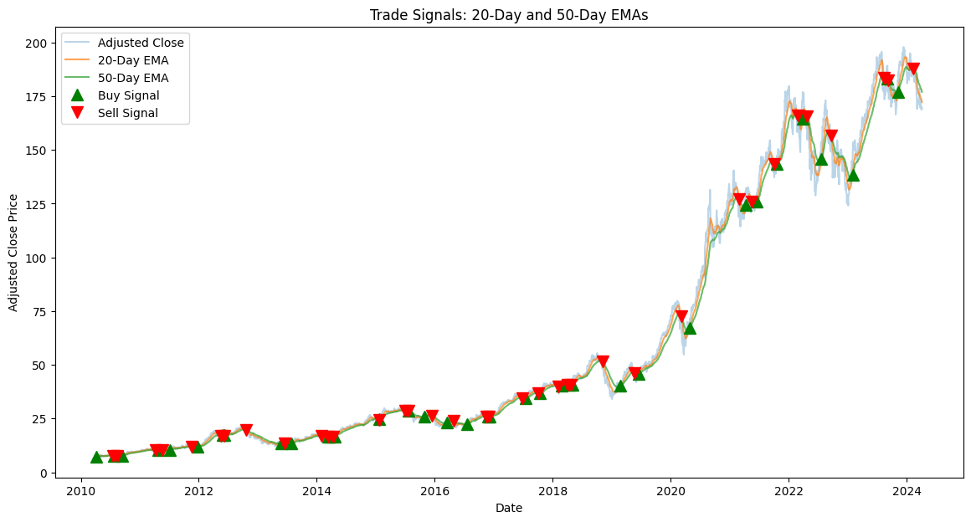
Exponential Moving Average (EMA)

Slide 11

Buy and Sell Analysis
A buy signal is generated when the short-term average crosses above the long-term average.
A sell signal is generated when the short-term average crosses below the long-term average.
These points are visualized on the plot with green upward-pointing triangles for buys and red downward-pointing triangles for sells.

Slide 12

CAPM (Capital Asset Pricing Model) Analysis

Slide 13

S&P 500 Total Returns: The average return of the S&P 500 over the last 10 years, calculated as 13.13%, serves as an estimate for the market return (R_m)
CAPM Calculation: With a risk-free rate (R_f) of 4.36%, a beta (β) of 1.28, and a market return (R_m) of 13.13%, the expected return on equity (E(R_i)) using the CAPM formula is approximately 15.58%.
The higher-than-expected return on equity (E(R_i)) of approximately 15.58% indicates that investors require a premium for holding the stock, reflecting its higher risk compared to the market. This suggests that the stock exhibits higher-than-average volatility, as indicated by its beta of 1.28, which contributes to the elevated expected return. Investors should carefully assess their risk tolerance and investment objectives before considering the stock, considering factors such as investment horizon, diversification, and overall portfolio risk.

Slide 14

WACC (Weighted Average Cost of Capital) Analysis

Slide 15
Findings
Total Market Value of Equity (E): Calculated as $2,624,694.80 million USD, based on the current stock price and shares outstanding.
Total Firm Value (V = E + D): The firm's total value amounts to $2,731,266.80 million USD, incorporating both equity and debt components.
Cost of Equity: Using the CAPM, the cost of equity is determined to be approximately 15.58%.
WACC Calculation: Applying the formula for WACC, the calculated WACC is approximately 15.05%.

Slide 16

The calculated WACC of approximately 15.05% serves as the weighted average cost of capital for the company, representing the blended cost of equity and debt financing.
This rate is utilized as the discount rate for evaluating the company's investment opportunities, guiding decisions on capital allocation and project viability.
While the calculated value provides a theoretical reference point, further analysis is necessary to understand any discrepancies between the calculated WACC and the market price, considering factors such as market conditions, industry dynamics, and company-specific risks.

Slide 17
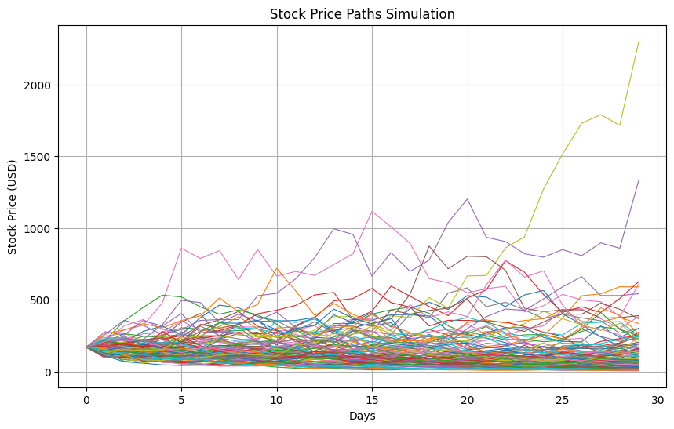
Monte Carlo Simulation
Initial Stock Price: $168.79
Annualized Volatility (σ): 20.69%
Net Profit Margin: 25.31%
Drift (μ): Net profit margin adjusted for a 2% risk-free rate.
Forecast Period: 30 days
Number of Simulations: 100
Notes:
Modeling Approach:
Daily Returns: Modeled using geometric Brownian motion
Assumptions: Logarithmic returns are normally distributed and independent
Forecast Calculation:
Method: Previous day’s stock price multiplied by simulated daily return
Iterations: Applied across 100 simulations for each forecast day
Visualization and Interpretation:
Display: 100 simulated stock price paths for the upcoming 30 days
Interpretation: Diversity in potential outcomes depicts market volatility
Insight: The variability in simulations reflects both risk and reward potential

Slide 18
Findings
The plot shows a wide range of possible paths for the stock price, reflecting the uncertainty and volatility inherent in stock markets. Some paths show a significant increase in the stock price, while others show a decrease. This highlights the risk and potential reward of investing in stocks.
The average trend of the paths could be interpreted as the expected stock price movement, but it’s important to note that actual future prices can deviate significantly from this average due to the randomness and unpredictability of stock markets.

Slide 19
Facebook Prophet
Objective: Utilize Facebook Prophet to project Apple Inc.'s stock trends based on historical data patterns.
Methodology: Time series analysis capturing daily seasonality and long-term trends.
Data Inputs: Historical stock prices formatted specifically for Prophet analysis.
Forecast Output: A predictive trend line, including confidence intervals, suggests continued growth.
Seasonality Insights: Identifies and visualizes underlying weekly and yearly patterns affecting stock prices.
Investor Takeaway: The forecast supports a positive outlook, bolstering confidence in Apple's ongoing market performance and innovation-driven growth.
Considerations: While indicative of growth, the forecast is one of several tools for investors, who should also consider market dynamics and individual risk profiles

Slide 20

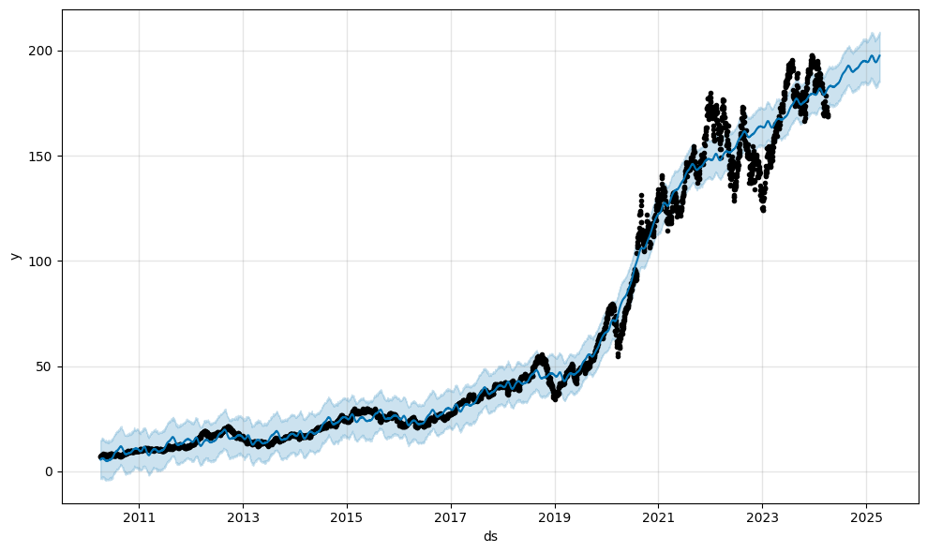
Graph 1:
This graph represents the historical stock prices and the projected future prices of Apple Inc., using the Facebook Prophet model. The black dots indicate the actual past stock prices, the blue line represents the model's fit to this historical data, and the light blue shaded area illustrates the uncertainty interval for the forecast. The trend shows a significant increase over the years, with an acceleration around 2017.

Slide 21
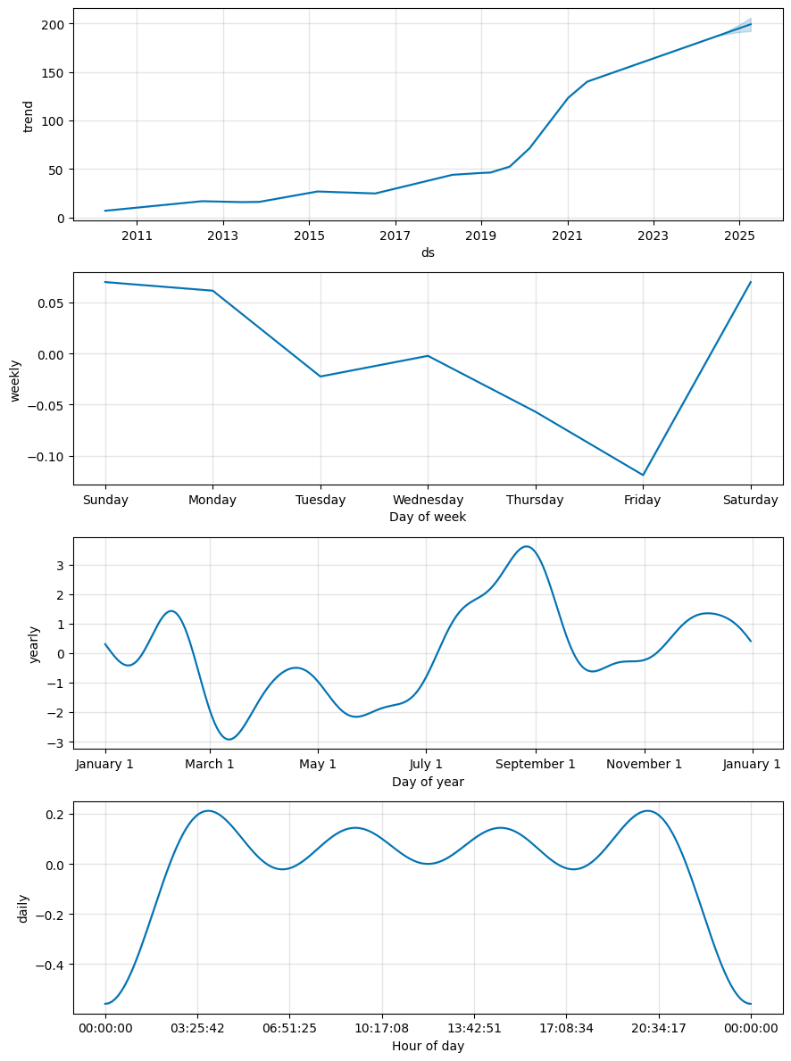
Graph 2:
This graph displays the decomposition of the forecast into different components:
The first subplot shows the overall trend component of the stock price, reflecting a long-term increase.
The second subplot indicates the weekly seasonality component, revealing how stock prices tend to behave differently on different weekdays.
The third subplot details the yearly seasonality, showing fluctuations that likely correspond to annual events and cycles in the company’s business operations.
The bottom subplot highlights the daily seasonality, which appears to show the intraday variation in stock prices, although such granularity is not typically the focus of long-term investors.

Slide 22
Analysis and Interpretation
Trend Component:
The trend component confirms a consistent growth in Apple's stock value, suggesting that the company is expanding and remains a dominant player in the tech industry. The projection also indicates that the growth trend is expected to continue.
Weekly Seasonality:
Weekly patterns demonstrate that prices might dip mid-week and then peak towards the end of the week. This could be due to various market factors, such as trading volumes and investor sentiment fluctuations.
Yearly Seasonality:
The yearly seasonality shows a more complex pattern, with peaks and troughs possibly aligning with Apple's product launch events, holiday sales cycles, or financial reporting periods.
Daily Seasonality:
Daily fluctuations are evident, with certain times showing higher variability. These patterns might be useful for day traders or those interested in short-term market movements.

Slide 23

Apple Inc., Prophet's forecasting can be instrumental in planning investment strategies. The model's ability to account for the company's specific growth cap and market saturation levels allows it to adapt to the upper limits of Apple's stock growth potential. The inclusion of product release cycles and the significant effect of holiday shopping seasons are uniquely addressed within Prophet's flexible modeling environment.
By leveraging this tool, analysts and investors can gain a nuanced understanding of Apple's stock price trajectory, backed by a data-driven, robust forecasting model that simplifies complex time series data into actionable insights.

Slide 24
Recommendations
Sustained Growth Outlook: Apple's enduring market leadership and innovative product pipeline suggest a positive long-term growth trajectory.
Financial Stability and Profitability: Robust profitability ratios and efficient asset utilization underscore Apple's solid financial stability.
Stock Price Volatility and Forecasting: While Monte Carlo simulations indicate potential volatility, the overall trend from the Facebook Prophet model projects upward growth.
Strategic Portfolio Inclusion: Apple's stock is recommended as a strategic addition to portfolios, especially for investors seeking long-term appreciation.
Diversification and Risk Management: Investors should maintain a diversified portfolio to mitigate risk, and Apple's forecasted growth can be a key component of a balanced investment strategy.
Active Monitoring and Dynamic Approach: Continuous monitoring of Apple's financials and market performance is advised to dynamically align investment decisions with evolving market conditions.
Buy, Hold, or Strategic Buying: Current investors should hold given the positive outlook. New investors might consider buying, particularly on dips aligned with the identified seasonal patterns, to capitalize on the forecasted growth.

Slide 25

Conclusion
This forecasting suggests optimism for Apple Inc.'s future stock performance. However, it's crucial to remember that forecasts are not guarantees and should be one of many tools used in making informed investment decisions. Monitoring market trends, staying informed about Apple's business strategies, and understanding broader economic factors are all essential practices for investors.

Slide 26
Thank You

